Slide 1


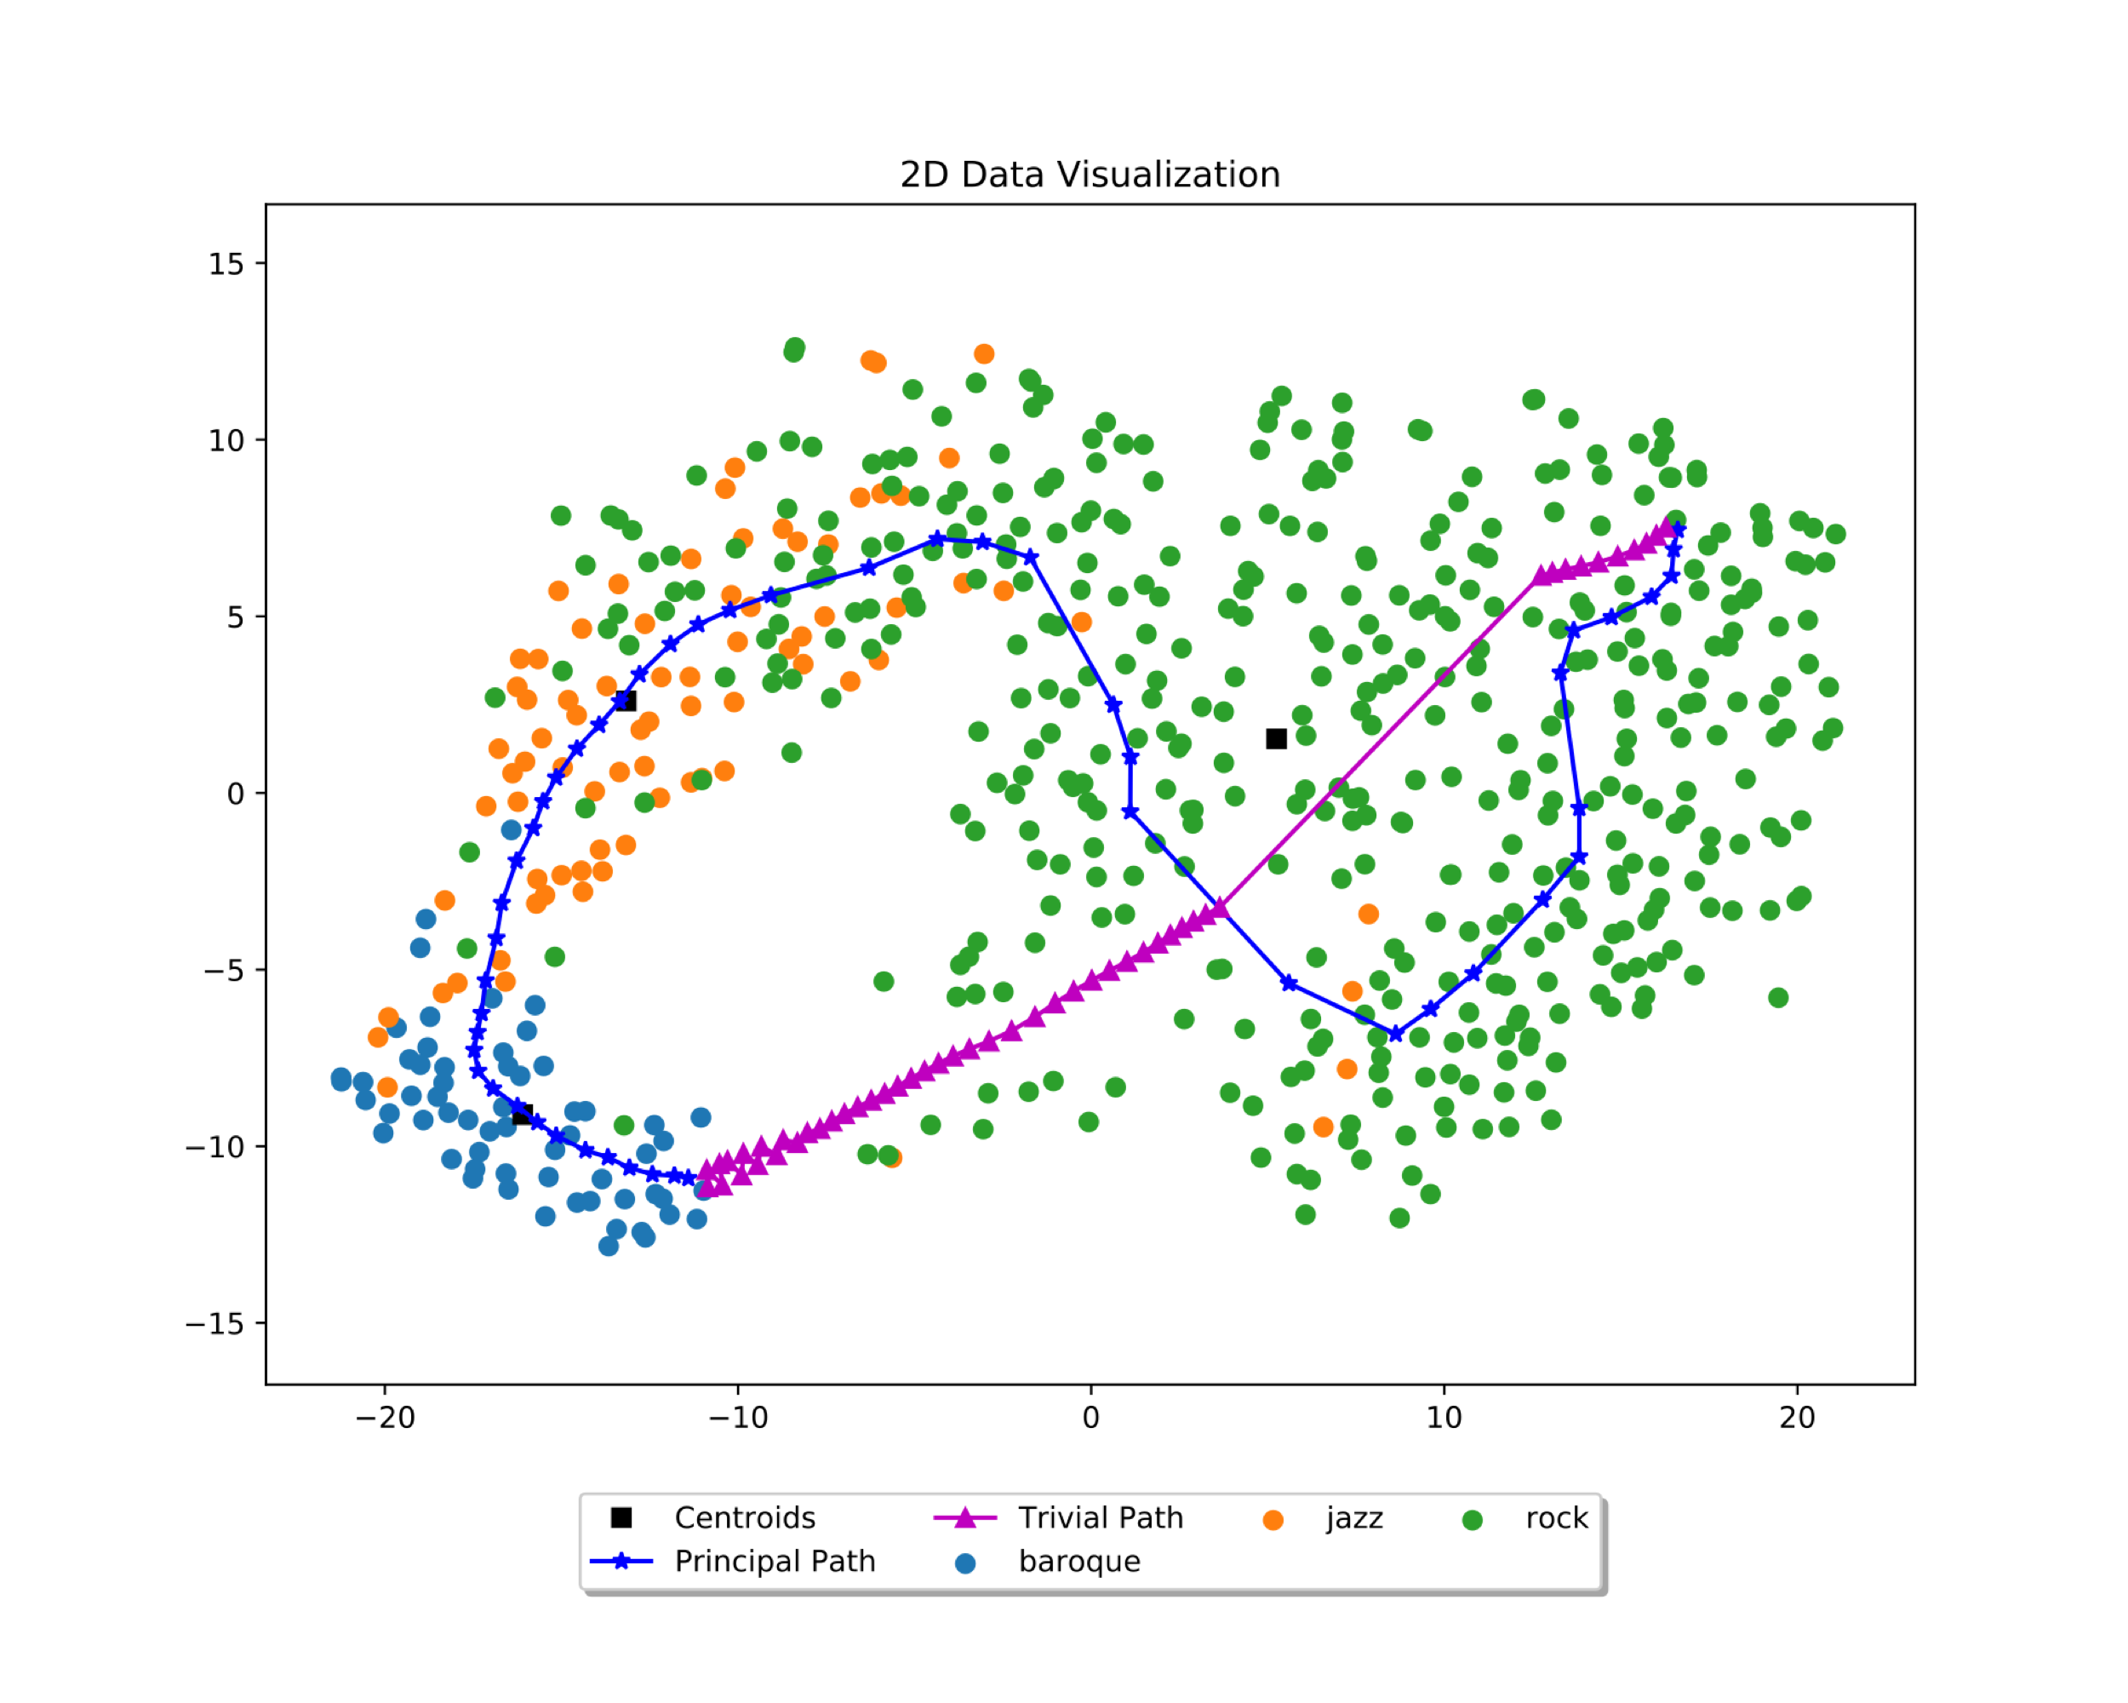
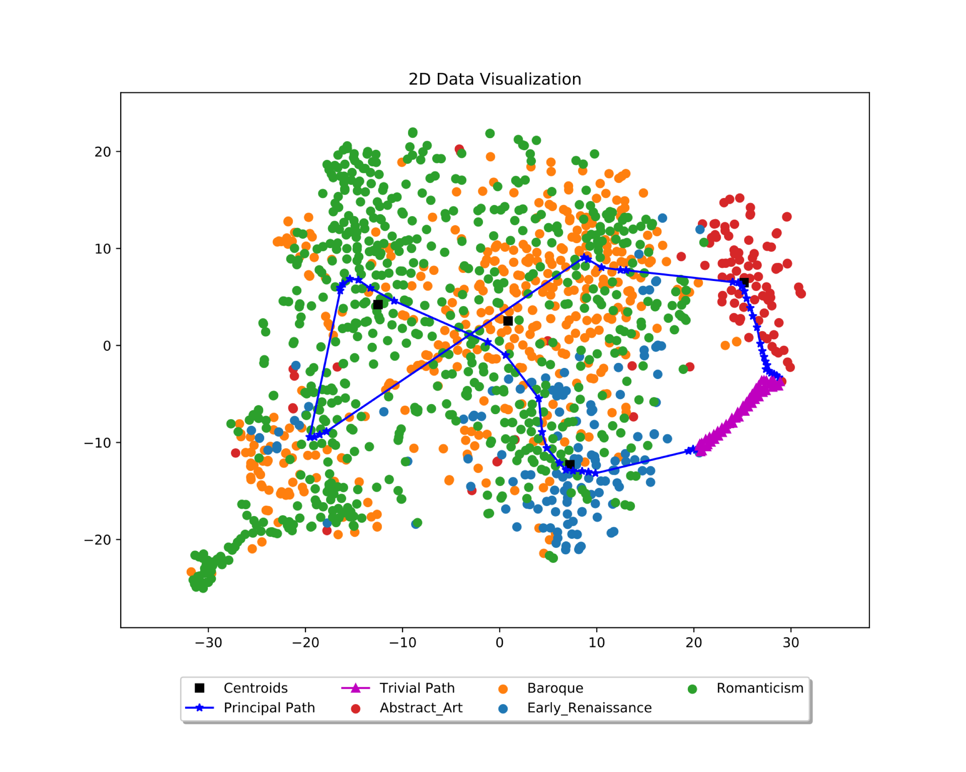
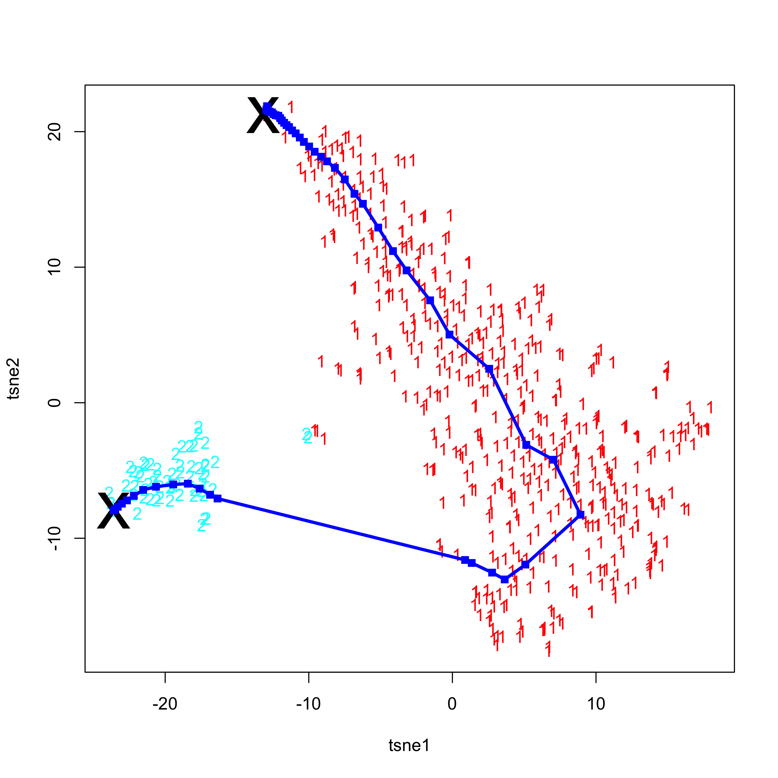
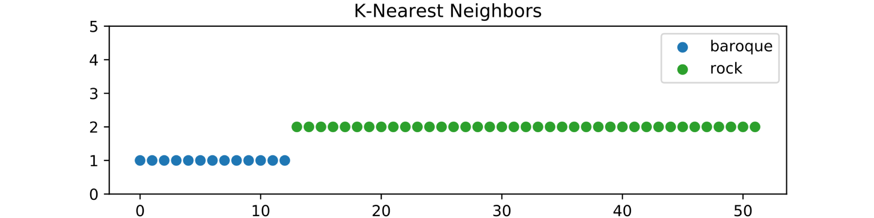
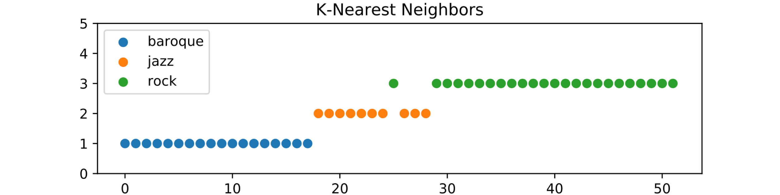
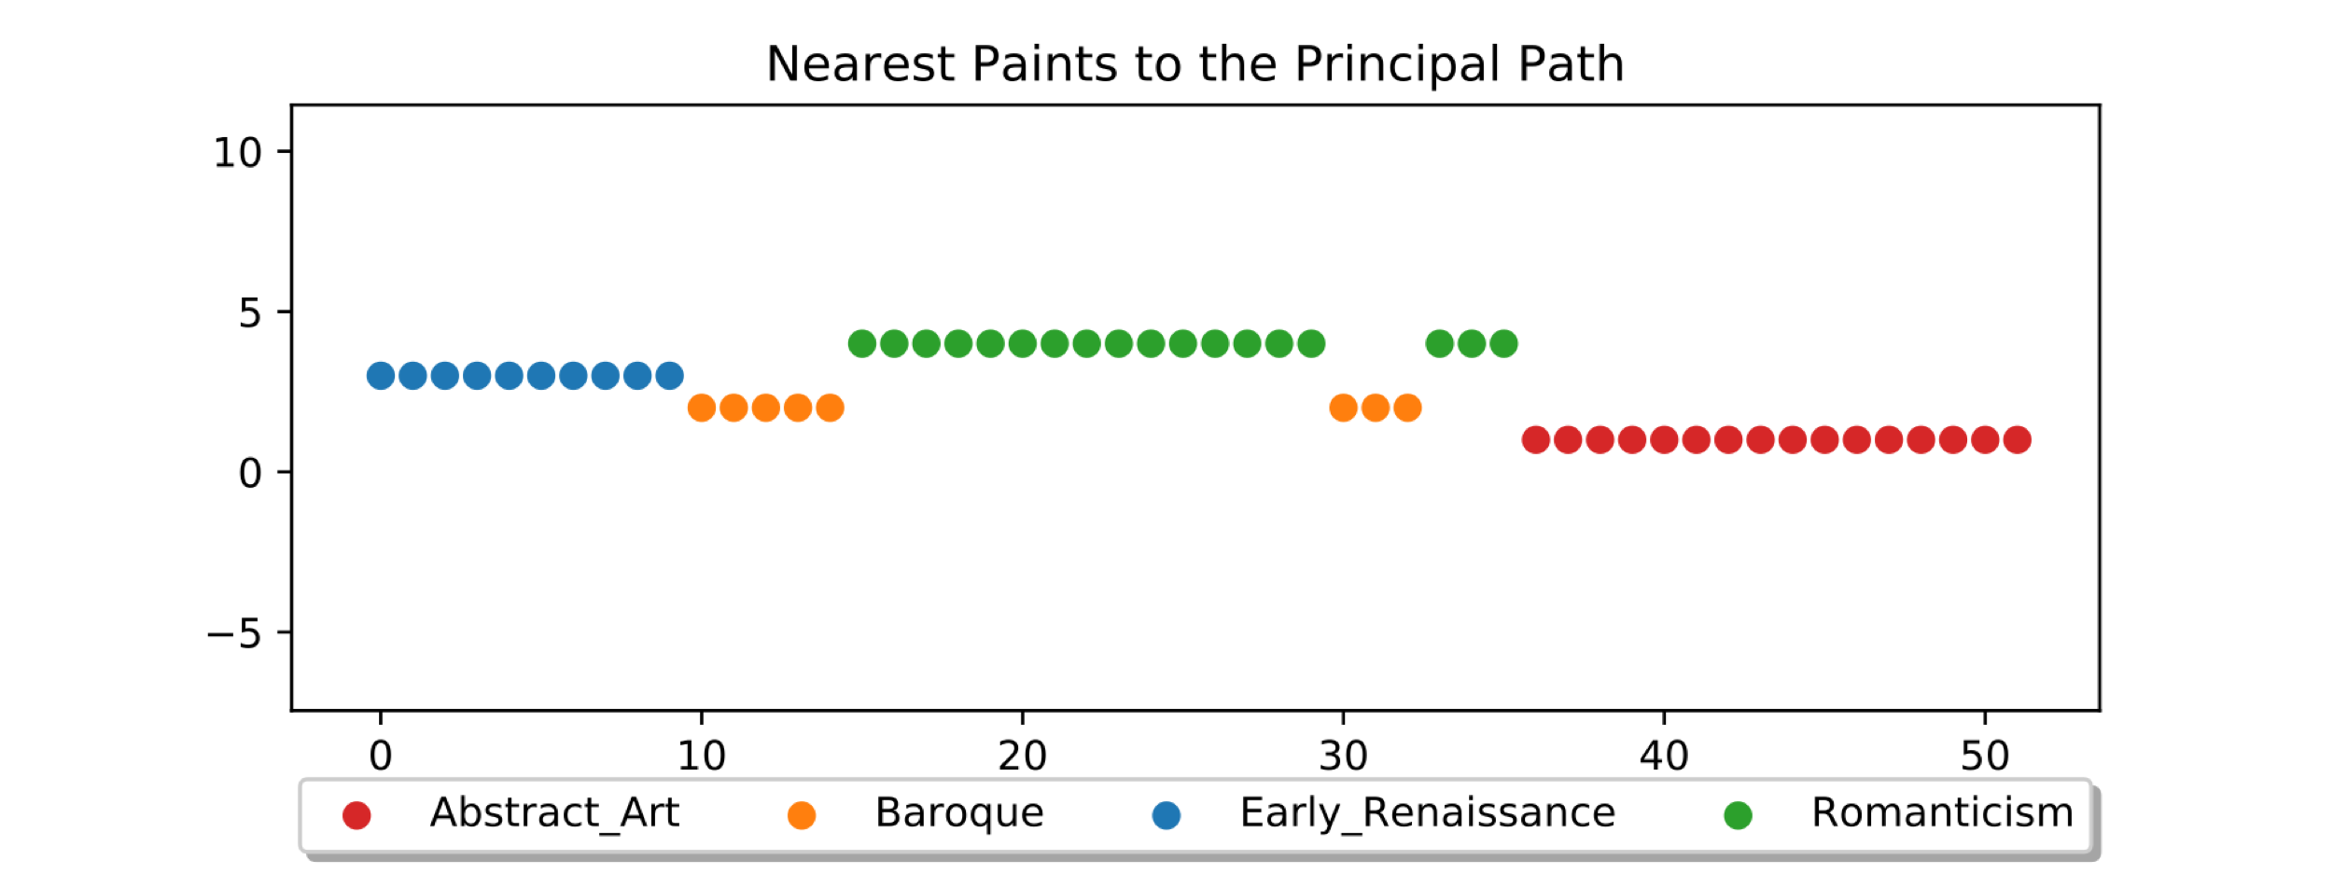
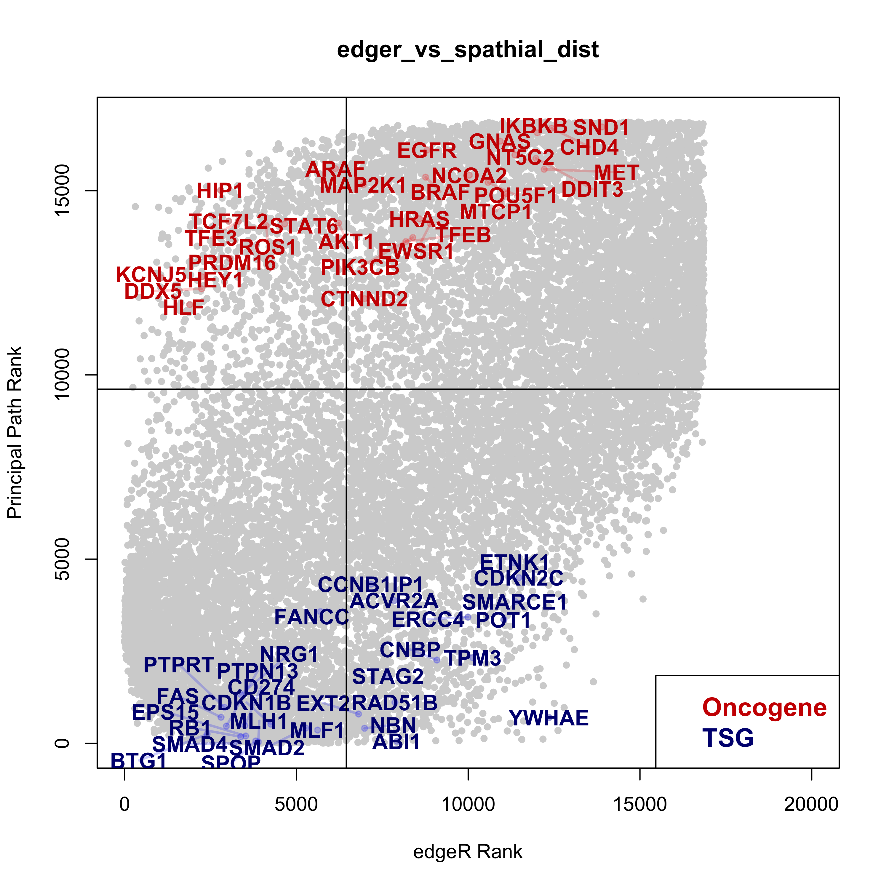
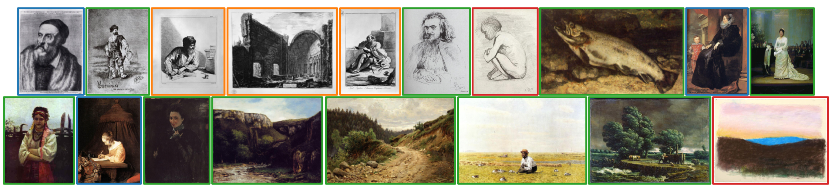
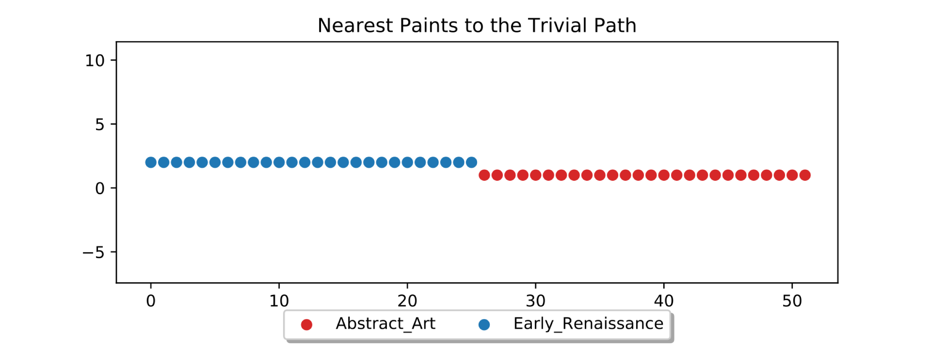
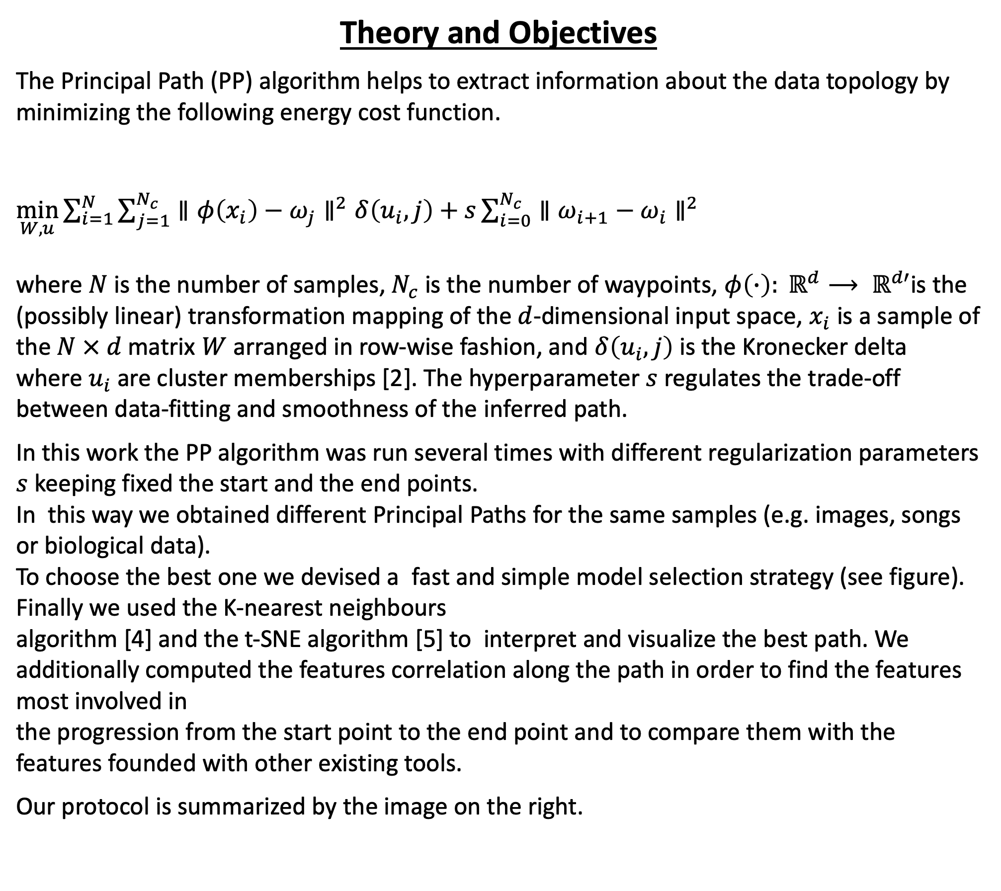
Navigating high-dimensional spaces
via the Principal Path algorithm
E. Gardini^{1,2}, S. Decherchi¹, A. Cavalli^{1,2}
¹ Computational & Chemical Biology, Italian Institute of Technology, via Morego 30, 16163 Genoa, Italy
² Dept. of Pharmacy and Biotechnology, University of Bologna, via Belmeloro 6, 40126 Bologna, Italy
Introduction
Topological methods have recently attracted the attention of the of Machine Learning and Neural Networks communities allowing to capture the global, holistic aspects within datasets [1].
The Principal Path algorithm is one of them and it is a tool to obtain an evolutionary analysis of a dataset. It takes two points as input and it tries to connect them taking into account the data fitting and the smoothness. The output of the algorithm is a set of waypoints, which are topologically connected via a chain of springs [2][3].
Evolutionary information can be very interesting for different reasons depending on the applicative contexts. Here, we choose two applications, in order to prove the versatility of the algorithm and to highlight its strengths. In particular, the method is applied to the visual arts and the music context and to a biological dataset.
Dataset:
Derived features from CNNs
(visual artworks and songs)
Human RNA-Seq samples from tumor
and physiological tissues
Theory and Objectives
The Principal Path (PP) algorithm helps to extract information about the data topology by minimizing the following energy cost function.
$\min_{W,u}{\sum_{i=1}^{N}{\sum_{j=1}^{N_{c}}{∥φ\left(x_{i}\right)−ω_{j}∥^{2}δ\left(u_{i},j\right)+s\sum_{i=0}^{N_{c}}{∥ω_{i+1}−ω_{i}∥^{2}}}}}$
where $N$ is the number of samples, $N_{c}$ is the number of waypoints, $φ\left(∙\right): ℝ^{d}⟶ ℝ^{d′}$is the (possibly linear) transformation mapping of the $d$-dimensional input space, $x_{i}$ is a sample of the $N × d$ matrix $W$ arranged in row-wise fashion, and $δ\left(u_{i},j\right)$ is the Kronecker delta
where $u_{i}$ are cluster memberships [2]. The hyperparameter $s$ regulates the trade-off between data-fitting and smoothness of the inferred path.
In this work the PP algorithm was run several times with different regularization parameters $s$ keeping fixed the start and the end points.
In this way we obtained different Principal Paths for the same samples (e.g. images, songs or biological data).
To choose the best one we devised a fast and simple model selection strategy (see figure). Finally we used the K-nearest neighbours
algorithm [4] and the t-SNE algorithm [5] to interpret and visualize the best path. We additionally computed the features correlation along the path in order to find the features most involved in
the progression from the start point to the end point and to compare them with the features founded with other existing tools.
Our protocol is summarized by the image on the right.
Protocol
PP₁
PP₂
…
PP_{n}
V₁
V₂
Elbow method
…
V_{n}
Best PP
Model selection
K-nearest neighbours
PCA
Correlation of the waypoints with the evolution
t-SNE
Visual representation
Results
Visual art
Music
TCGA Lung adenocarcinoma
Conclusions
The PP found reasonable connections between visual artworks and between songs from very different genres, partially respecting their historical evolution.
For biological data comparing the PP with a commonly used algorithm for DGEA, edge R, we found that both algorithms are partially overlapped (scatterplot of each gene: DE in edgeR, path correlation for the PP) even if the Principal Path is able to identify a handful of specific tumor-progression genes which are missed by a standard pairwise comparison.
References
[1] G. Carlsson, “Topology and Data,” Bulletin of The American Mathematical Society – BULL AMER MATH SOC, vol. 46, pp. 255–308, Apr. 2009.
[2] M. J. Ferrarotti, W. Rocchia, and S. Decherchi, “Finding Principal Paths in Data Space,” IEEE Transactions on Neural Networks and Learning Systems, vol. 30, pp. 2449–2462, Aug. 2019
[3] E. Ragusa, P. Gastaldo, R. Zunino, M. J. Ferrarotti, W. Rocchia, and S. Decherchi, "Cognitive Insights into Sentic Spaces Using Principal Paths", Cognitive Computation, July 2019.
[4] T. Cover and P. Hart, “Nearest neighbor pattern classification,” IEEE Transactions on Information Theory, vol. 13, pp. 21–27, Jan. 1967.
[5] L. van der Maaten and G. Hinton, “Visualizing data using t-SNE,” Journal of Machine Learning Research, vol. 9, pp. 2579–2605, Nov. 2008.
References
[1] G. Carlsson, “Topology and Data,” Bulletin of The American Mathematical Society - BULL AMER MATH SOC, vol. 46, pp. 255–308, Apr. 2009.
[2] M. J. Ferrarotti, W. Rocchia, and S. Decherchi, “Finding Principal Paths in Data Space,” IEEE Transactions on Neural Networks and Learning Systems, vol. 30, pp. 2449–2462, Aug. 2019
[3] E. Ragusa, P. Gastaldo, R. Zunino, M. J. Ferrarotti, W. Rocchia, and S. Decherchi, “Cognitive Insights into Sentic Spaces Using Principal Paths,” Cognitive Computation, July 2019.

